Slide 1
Report
Sep-2023 MP Inspection BFX – UA300
Date : 19-Oct-2023
Prepared by: Rachel Ruan

Slide 2
Issue Description
12-Oct, ALT customer complain [BFX-UA300] Sep – 2023 Mass production issue.
Overall inspection result => Conditional Pass (Waived)
Defect Total:
Critical
• Issue not inserting into USB 2.0 port * 1pcs
• Minor
• RJ 45 Cable function NG *1psc

Slide 3
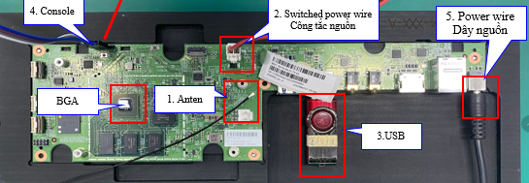
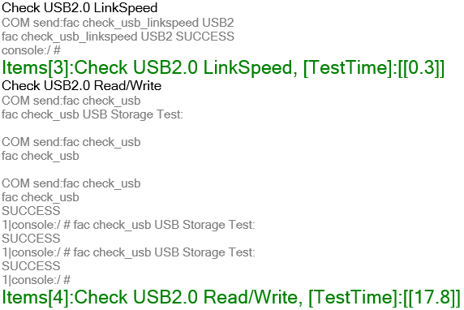
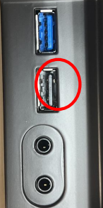
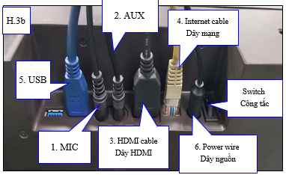
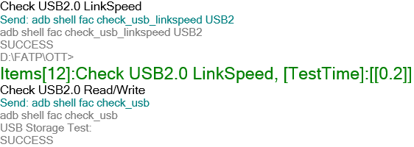
1. Issue not inserting into USB 2.0 port * 1pcs
Issue Description | Root cause | Actions | Status
Symptom: Issue not inserting into USB 2.0 port Type: Critical Defect unit Q’ty : 1/200pcs Defect rate : 0.5% SKB SN: 2149695001202303011195 | 1. Customer check visual check : damaged pin on USB 2.0 port and customer can not inserting into USB 2.0 port . 2. Check FATP data Product test FATP pass normally. Recheck log test on BT and FT1 station: ➔ Check log test, Result: PASS | AS check this SN : 2149695001202303011195 All FATP is normal process. No any repair or dis-assembly housing recode. If can, Fii want check NG sample for more analysis and take action improved on line production.

Slide 4
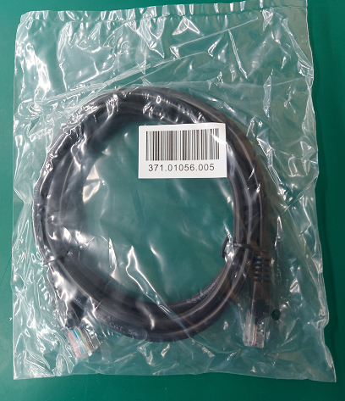
2. RJ 45 cable high speed not supported * 1pcs
Issue Description | Root Cause | Action | Status
Symptom: RJ 45 Cable function NG *1psc Type: Minor Defect unit Q’ty : 1/200pcs Defect rate : 0.5% | Check RJ45 data : 371.01056.005 - DC20230817 ( 20K ). Vendor FIT 2. RJ45 is accessory material. Online no any function test. On IQC station - IQC test connecter testing follow AQL: 10 ( Function test ). 3. Vendor FIT confirm function connecter test 100% on process. | 1. Feedback vendor for re-check all material on stock. Done 15-Oct-2023. 2. Fii waiting NG sample for more analysis find out root cause and corrective action.

